Slide 1
Introduction to Architecture for Software Systems
Bulat Gabbasov

Slide 2
What is software architecture?

Slide 3
What is software architecture?
Requirements
Are requirements good enough?
???
How to proceed from requirements to implementation?
Implementation

Slide 4
What is software architecture?
Requirements
Ad hoc
Requires gurus
Unpredictable
Costly
A miracle happens
Implementation

Slide 5
What is software architecture?
Requirements
Move from ad-hoc and lots of intuition approach to disciplined engineering approach
Describe requirements in a way that an architecture can be rationally evaluated
Build architecture from known parts, understands styles, patterns and tactics
Produce good architectural documentation
Software Architecture
Implementation

Slide 6
What is software architecture?
The software architecture of a computing system is the set of structures needed to reason about the system, which comprise software elements, relations among them and properties of both.
*Documenting Software Architecture: Views and Beyond, 2nd Ed. Clements et al. 2011.

Slide 7
What is software architecture?
Another reason why do you need to learn about software architecture is because of System Design interviews.
Usually you are given very vague definition of a problem. Example:
Design url shortener service
Design a web crawler
Design Facebook newsfeed
Your goal:
Gather and refine requirements
Design and analyze a solution that satisfies the requirements

Slide 8
Example

Slide 9
Example
Suppose you are asked to build a file system…
What is a file system?
POSIX - The Portable Operating System Interface (POSIX) is a family of standards specified by the IEEE Computer Society for maintaining compatibility between operating systems. POSIX defines the application programming interface (API), along with command line shells and utility interfaces, for software compatibility with variants of Unix and other operating systems
https://en.wikipedia.org/wiki/POSIX

Slide 10
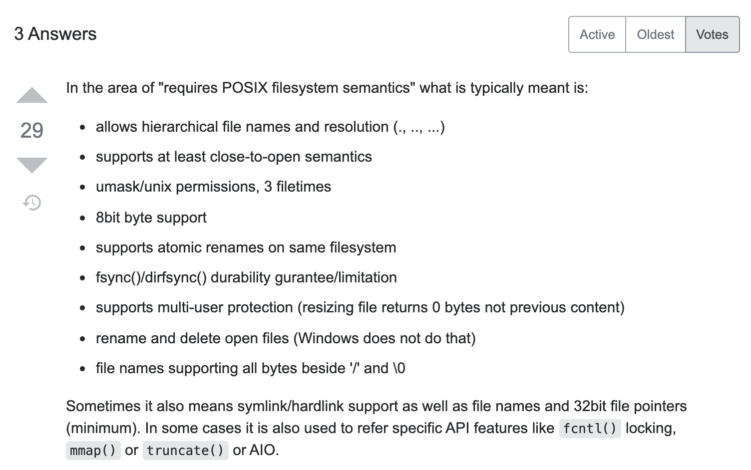
Example
POSIX compatible file system
https://stackoverflow.com/questions/18550253/what-is-posix-compliance-for-filesystem

Slide 11
Example
Application layer works with files and folders.
It can create, rename, edit or delete files.
Operating system layer introduces entities like folders and files.
It works with storage layer and API depends on a given storage type.

Slide 12
Example

Slide 13
Example
Some existing file systems:
FAT32 – up to 4 GB files due to 32-bit limit
ExFAT
NTFS
ext3, ext4, …
IBM Linear Tape File System - Single Drive Edition – allows to store data into magnetic tapes
NFS, AFS – network file systems

Slide 14
Example
What if:
I need to support 1000s of users?
I need to support very large files? Up to 100s GBs?
I need to support very large capacity? Up to 100s TBs?
Maybe Google File System?

Slide 15
Architectural Drivers

Slide 16
Business context
The overall business context needs to be recognized
The aspects of the business context that impact the system need to be identified
These aspects of the business context need to be articulated in a way that’s actionable
The relationship between design decisions and these business concerns need to be understood
If the business context cannot be fully accommodated, the business context needs to be refined in a way that can be supported by the design

Slide 17
Architectural Alignment
Business Context
Architectural Drivers
Design Decision

Slide 18
Architectural Drivers
Functional requirements
Business constraints
Time
Budget
Team size
Technical constraints
Legacy systems
Programming language
Quality attributes

Slide 19
Quality attributes
Quality Attributes – characteristics that the system must possess in addition to the functionality
These are sometimes called non-functional requirements or systemic properties
Of the architectural drivers, quality attributes are the most difficult to uncover, write down, and verify in the design
Quality attributes and constraints drive architectural structure more than functionality

Slide 20
Quality attribute scenarios
Stimulus | A condition that affects the system
Source of the stimulus | The entity that generated the stimulus
Environment | The condition under which the stimulus occurred
Artifact stimulated | The artifact that was stimulated by the stimulus
Response | The activity that results because of the stimulus
Response measure | The measure by which the system’s response will be evaluated

Slide 21
Example
“A server experiences a processor failure while under peak load. The system continues to operate without losing any data and without the average latency degrading.”

Slide 22
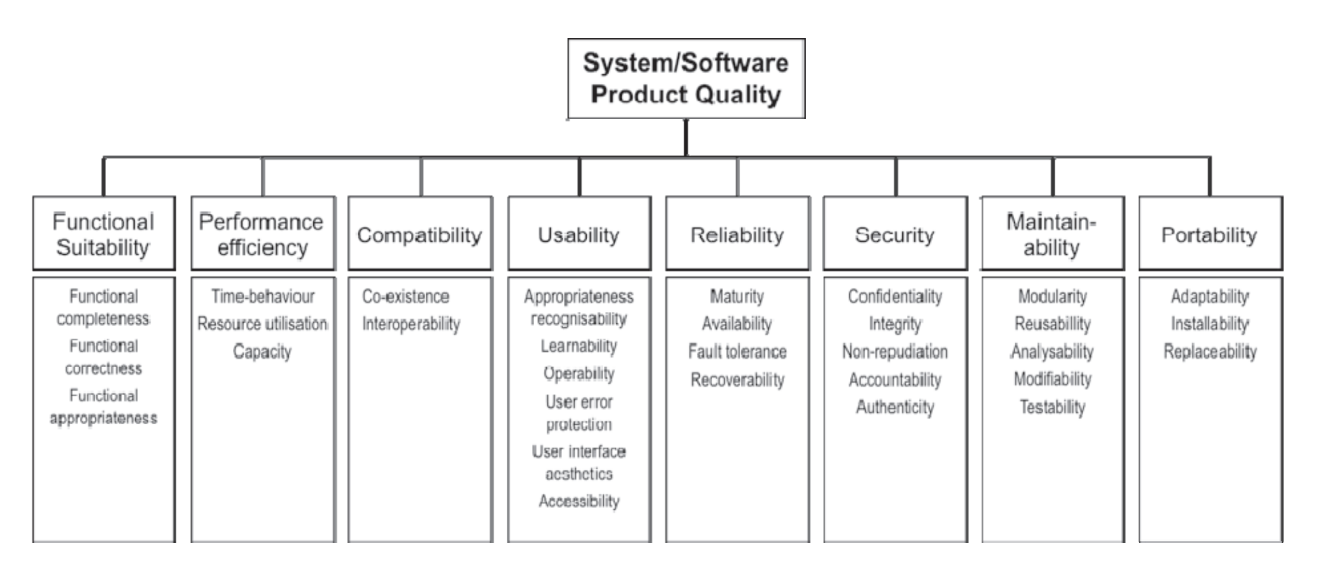
Architectural Drivers
ISO/IEC 25010:2011

Slide 23
Stakeholders
Stakeholders should not only be involved but should be in a position to recognize tension and prioritize objectives
This should be done upfront as well as on an ongoing basis when key tradeoffs are being evaluated
Stakeholder centric approaches can be helpful with this

Slide 24
Example

Slide 25
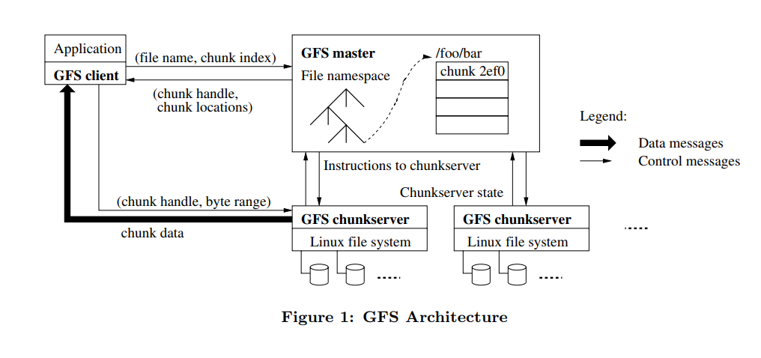
Example: Google File System
Source: “The Google File System” Sanjay Ghemawat, Howard Gobioff, and Shun-Tak Leung. SOSP 2003.

Slide 26
Why Google File System?
Distributed system
Parallel performance
Fault tolerance
Replication
Consistency
Successful real-world design

Slide 27
GFS: Functional Requirements
Almost POSIX compliance
Additional support for concurrent append operations
Snapshot support
Snapshot creates a copy of a file or a directory tree at low cost.

Slide 28
GFS: Technical constraints
Component failures are the norm rather than the exception
there are consists 100s – 1000s machines per cluster
components are built from inexpensive commodity hardware parts
the system is accessed by 100s – 1000s of client machines
some components are not functional at a given time
some components will not recover from failure
The system is built from many inexpensive commodity components that often fail. It must constantly monitor itself and detect, tolerate, and recover promptly from component failures on a routine basis.

Slide 29
GFS: Technical constraints
$$P\left(failure\right)=0.1\%$$
$$P\left(at least one failure\right)={1−(1 −P\left(failure\right))}^{1000}≈63\%$$

Slide 30
GFS: Quality Attributes
Files are huge
a typical file size is measured in GBs – TBs
The system stores a modest number of large files. We expect a few million files, each typically 100 MB or larger in size. Multi-GB files are the common case and should be managed efficiently. Small files must be supported, but we need not optimize for them

Slide 31
GFS: Quality Attributes
Most files are mutated by appending new data rather than overwriting existing data
once written, the files are only read, and often only sequentially.
Multiple clients can append data
The workloads primarily consist of two kinds of reads:
large streaming reads
A typical read is 1MB or more
Successive operations from the same client often read through a contiguous region of a file
small random reads
Random read typically reads a few KBs at some arbitrary offset
Performance-conscious applications often batch and sort their small reads to advance steadily through the file rather than go back and forth

Slide 32
GFS: Quality Attributes
Relaxed consistency requirements
File namespace mutations are atomic
Append causes a record to be atomically appended at least one
- but it might be duplicated or GFS may decide to add a padding

Slide 33
GFS: Why is it hard?
Performace
Sharding
Faults
Tolerance
Replication
Consistency

Slide 34
Strong Consistency
C1: R1
C2: R2

Slide 35
No Consistency
C1: R1
C2: R2
C2: R2
C1: R1

Slide 36
Eventual Consistency

Slide 37
Example: Google File System
Source: “The Google File System” Sanjay Ghemawat, Howard Gobioff, and Shun-Tak Leung. SOSP 2003.

Slide 38
GFS: Metadata
File namespace and chunk namespace
Mapping from files to chunks
Location of chunk replicas
All data is in master memory
Namespaces and file-to-chunk mappings are logged
The master does not store chunk location informa- tion persistently. Instead, it asks each chunkserver about its chunks at master startup and whenever a chunkserver joins the cluster.

Slide 39
Master data
In memory
Filename
array of chunks
handle
list of chunkservers
version #
primary
lease expiration
Disk
log
checkpoint

Slide 40
GFS: Sequence diagram

Slide 41
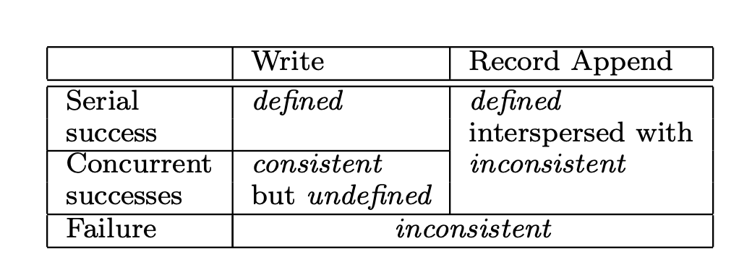
GFS: Consistency Model
A file region is consistent if all clients will always see the same data, regardless of which replicas they read from.
A region is defined after a file data mutation if it is consistent and clients will see what the mutation writes in its entirety.

Slide 42
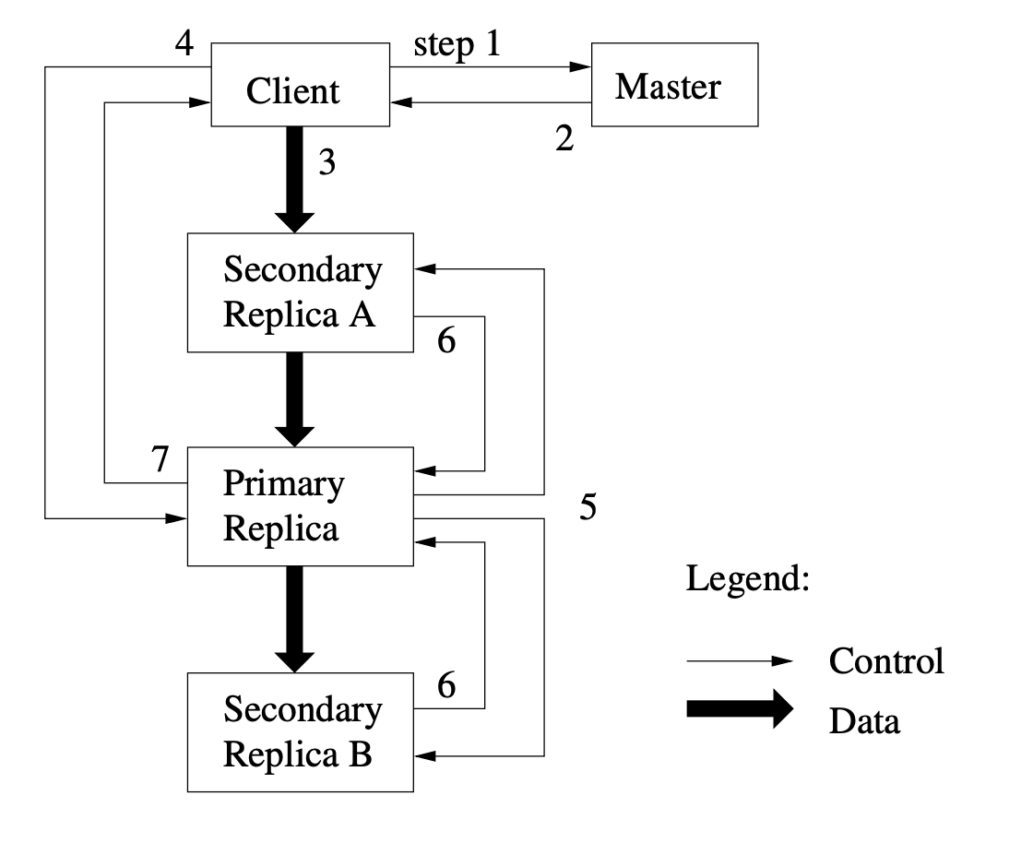
GFS: Mutations
The client asks the master which chunkserver holds the current lease for the chunk and the locations of the other replicas.
The master replies with the identity of the primary and the locations of the other (secondary) replicas.
The client pushes the data to all the replicas.
Once all the replicas have acknowledged receiving the data, the client sends a write request to the primary.
The primary forwards the write request to all secondary replicas.
The secondaries all reply to the primary indicating that they have completed the operation.
The primary replies to the client.

Slide 43
GFS: Single Master
Master stores metadata in memory
Master does not keep location of chunks
Instead it reads it from chunk servers on start-up
Master monitors availability of chunk-servers by receiving hearbeats from chunk server
Single point of failure

Slide 44
Latency comparison numbers
L1 cache reference | 0.5 ns
Branch mispredict | 5 ns
L2 cache reference | 7 ns | 14x L1 cache
Mutex lock/unlock | 25 ns
Main memory reference | 100 ns | 20x L2 cache, 200x L1 cache
Compress 1K bytes with Zippy | 10,000 ns
Send 1 KB bytes over 1 Gbps network | 10,000 ns
Read 4 KB randomly from SSD* | 150,000 ns | ~1GB/sec SSD
Read 1 MB sequentially from memory | 250,000 ns |  | 4,000 MB/s
Round trip within same datacenter | 500,000 ns |  | 2,000 round trips per second within a data center
Read 1 MB sequentially from SSD* | 1,000,000 ns | ~1GB/sec SSD, 4X memory | 1,000 MB/s
HDD seek | 10,000,000 ns | 20x datacenter roundtrip
Read 1 MB sequentially from 1 Gbps | 10,000,000 ns | 40x memory, 10X SSD | 100 MB/s
Read 1 MB sequentially from HDD | 30,000,000 ns | 120x memory, 30X SSD | 30 MB/s
Send packet CA->Netherlands->CA | 150,000,000 ns |  | 6-7 world-wide round trips per second

Slide 45
GFS: Chunk size
Chunk size is 64 MB
Pros:
Better performance because by keeping persistent TCP connection
Cons:
Small files may become hot-spots because they are at the same chunk server with few replicas
Solution: add more replicas

Slide 46
GFS: Availability
Master and chunk servers restore their state on start
Chunks are replicated to server on different racks
Master state is replicated
Replicated masters provide read-only access when master is down

Slide 47
GFS: Performance

Slide 48
Structures

Slide 49
What is structure?
Architecture design documentation is an abstraction of real structures
Drawings are representations of structures to-be-built or as-built systems
Drawings alone are not architecture, architectures have real structures found in real systems
Structures are implementation oriented – they are real things
Code
Process
Queue

Slide 50
Perspective & Views
A representation of a structure(s) from a particular perspective is called a view of the system.
A view is a partial representation of the system from a given perspective.
Software architecture design documentation is comprised of a collection of views.
There are 3 perspectives
Static (code structure, modules, libraries, uses)
Dynamic (process, threads, dataflows, call-return)
Physical perspective (computers, routers, wired/wireless)

Slide 51
Perspectives & Views
Structure is real
Architecture design document is an abstraction of real structure
View is a representation of a structure from a particular perspective
There are 3 perspectives
Static (code structure, modules, libraries, uses)
Dynamic (process, threads, dataflows, call-return)
Physical perspective (computers, routers, wired/wireless)

Slide 52
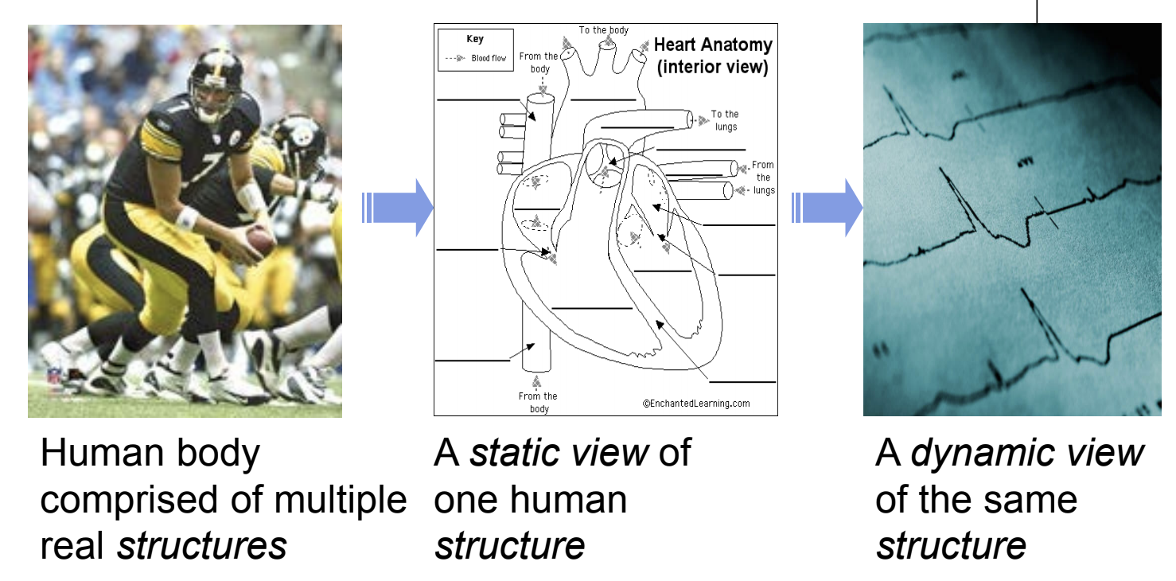
Perspectives & Views

Slide 53
Web Application: Static view
Elements: layers, libraries
Relations: uses
Systemic properties: reusability, modifiability, …

Slide 54
Web Application: Dynamic View
Elements: processes
Relations: call-return
Systemic properties: latency, throughput, reliability, …

Slide 55
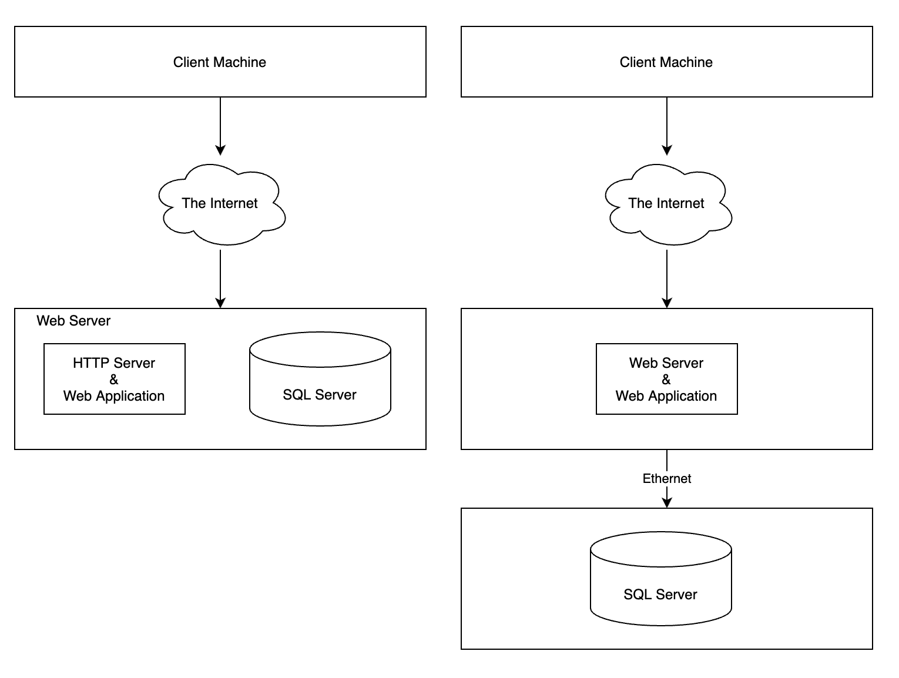
Web Application: Physical View
Elements: artifacts
Relations: deployed-to, ethernet
Systemic properties: reliability, scalability, …

Slide 56
Perspectives, Structures, Relations
Perspective | Example Structures | Example Relations | Views
Dynamic | Processes Threads … | Dataflow Events … | Component & Connector
Static | Layers Code Modules … | Depends Uses … | Module
Physical | Computers Sensors … | Ethernet Wireless … | Allocation

Slide 57
Architectural styles
A style is a broad description of a family of systems with similar traits that occur repeatedly in practice.
Examples: data flow styles, distributed styles, event styles

Slide 58
Architectural Patterns
Architectural patterns are primitive, general structures:
Patterns are language independent reoccurring structures used to solve reoccurring problems (e g. problem solution pairing).
Patterns possess known gross properties.
Provides a common vocabulary for designers.
Architectural patterns are not architectures but provides a starting point in architecture design.
The selection of an architectural pattern is often the architect’s first major design choice.

Slide 59
Tactics
A tactic provides a scheme for refining the elements of a software system and the relationships between them. Tactics...
are independent of a particular programming language and are independent of structure
consist of finer granularity details than architectural patterns
directly promote quality attribute properties
can be applied to various structures or ensembles to refine their quality attribute responses

Slide 60
Design patterns
The term “design patterns” was coined by Gamma et. al.
The focus of Gamma’s work is on design patterns that are more fine grained than styles, tactics, architectural patterns
Often they are decidedly language dependent.
The term “object oriented architectures” is used.
The focus is code/module structure.
Broad system properties and software intensive system design is not the focus at this abstraction.

Slide 61
Idioms
An idiom is a low-level code oriented pattern or primitive data structure.
Often specific to
a programming language
example: java observer, observable
language type (maybe unique to OO languages)
examples: inheritance, polymorphism
Idioms and Design Patterns will not be discussed as part of this course – although they are an important part of detailed element design!

Slide 62
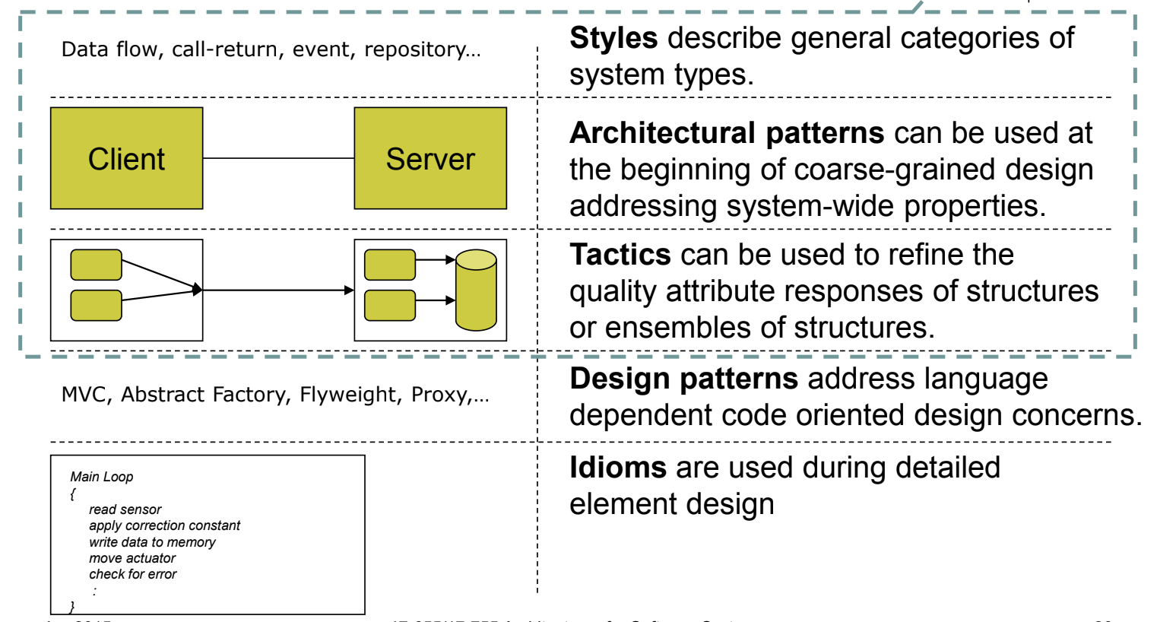
Relation between styles, patterns, tactics & design patterns

Slide 63
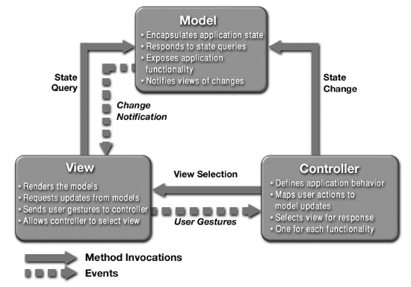
MVC
What is this? O_O

Slide 64
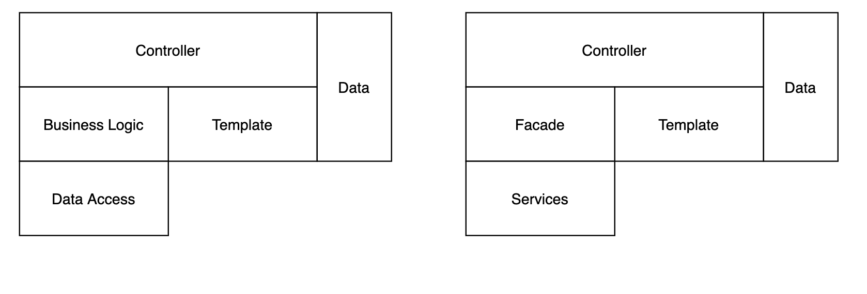
MVC: My view

Slide 65
MVC: My view
Controller is responsible for:
Parsing & validating input
Calling methods from business logic to construct data object
Selecting template and passing it constructed data object
Data is a pure representation of the data needed to render presentation
Data object contains only the part of business logic which does not require input/output operation, i.e. no reading from database
Business logic is responsible for doing actual job, i.e. it receives parameters in a ”strongly typed” way, so it can be reused in other parts of the system independent of HTTP nature of the service
It is ok to put some business logic into controller but be ready that you will not be able to reuse the logic in other parts of the system
But if you want to reuse it is simply creating another class with “strongly typed params” and copy/pasting the code there with very small changes

Slide 66
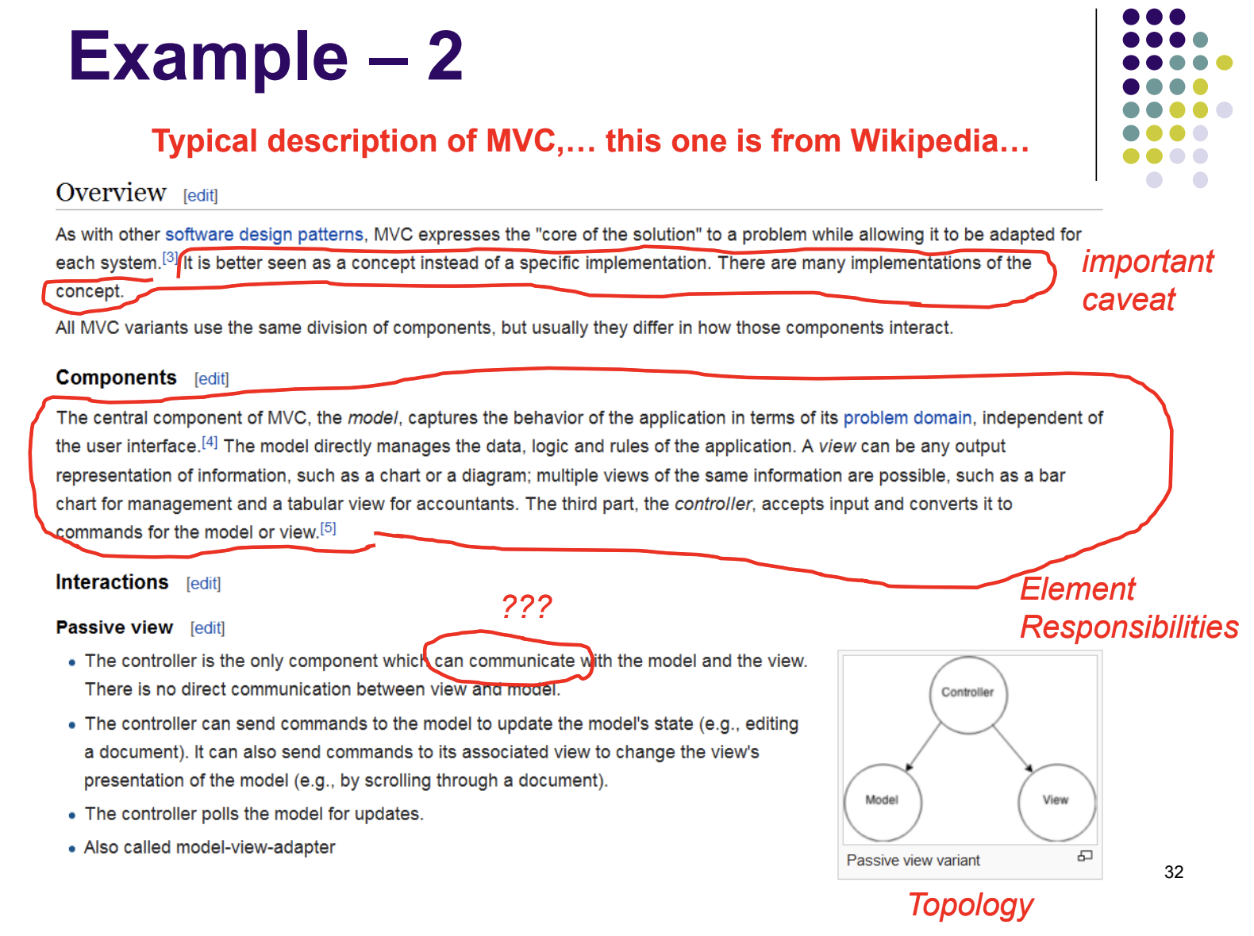

Slide 68
The most common design
Controller Parse input & validate Pass the input to ”business logic” layer Output result
Business logic Do the job
Data Access Hide storage implementation details Return data in form of objects

Slide 69
Coupling/Decoupling
Decoupling is a technique of partitioning a system into independent, self-sufficient elements.
Pros:
easier to make certain classes of changes
Cons:
can inhibit performance
can make determinism difficult to achieve
often results in larger code base
may result in inter-element communication complexity
security can be a challenge because of exposed inter-element communication

Slide 70
Coupling/Decoupling
Coupling is opposite of decoupling.
Pros:
can promotes better/predictable performance
can result in more predictable memory usage and executable footprint
can promote security by reducing inter-element exposure
Cons:
inhibits modifiability
may result in monolithic complex software, inhibiting long-term software maintainability

Slide 71
Cohesion
Cohesion is about how we assign responsibilities to elements.
a highly cohesive structure is one that has a single, or small set of closely related responsibilities allocated to it
systems exhibiting low cohesion distribute individual responsibilities across elements
Cohesion can be applied in each perspective
Promoting high cohesion is generally a best design practice
eases construction, test, team alignment, easier to find defects and isolate elements for modification and maintenance.
cohesion can be difficult to maintain in environments where requirements are volatile
Cohesion is not just about functional responsibilities, but also quality attribute responsibilities.

Slide 72
Documenting Software Architecture

Slide 73
Documenting Software Architecture
Usually consists of informal prose plus box-and-line diagram
Lots of appeal to intuition
Little precision, rarely precise

Slide 74
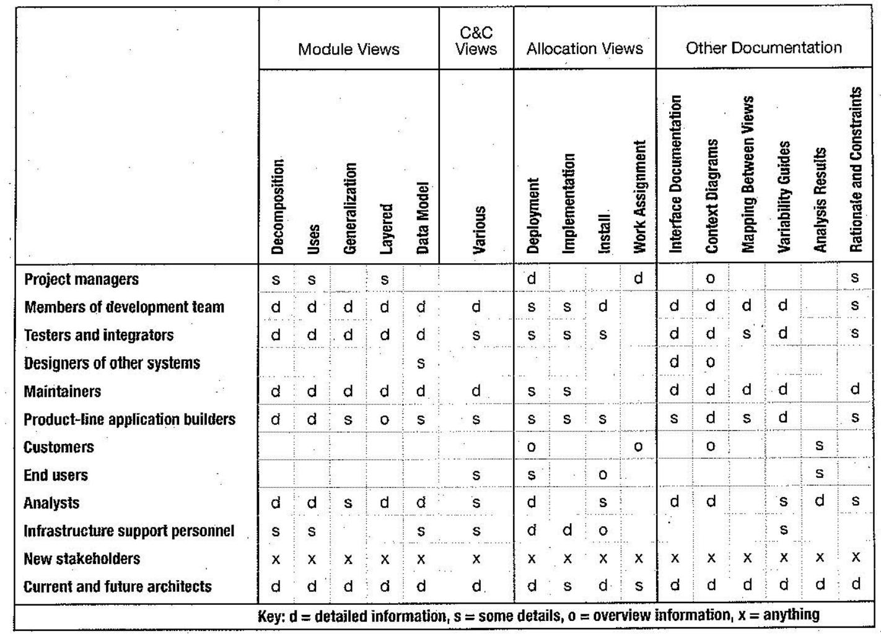

Slide 76
Availability
Availability refers to the ability of a system to mask or repair faults such that the cumulative service outage period does not exceed a required value over a specified time interval.
$$\frac{MTBF}{MTBF+MTTR}$$
where MTBF refers to the mean time between failures and MTTR refers to the mean time to repair.
Failure is observed fault, i.e. if a fault is not visible then there is no failure.

Slide 77
Availability general scenario

Slide 78
Availability tactics

Slide 79
Modifiability
Change happens…

Slide 80
Modifiability
Cost of change
The cost of introducing the mechanism(s) to make the system more modifiable
The cost of making the modification using the mechanism(s)
For N similar modifications, a simplified justification for a change mechanism is that
N × Cost of making the change without the mechanism ≤ Cost of installing the mechanism + (N × Cost of making the change using the mechanism).
N is the anticipated number of modifications that will use the modifiability mechanism, but N is a prediction.

Slide 81
Modifiability
Source of stimulus. This portion specifies who makes the change: the developer, a system administrator, or an end user.
Stimulus. This portion specifies the change to be made. A change can be the addition of a function, the modification of an existing function, or the deletion of a function. (For this categorization, we regard fixing a defect as changing a function, which presumably wasn’t working correctly as a result of the defect.) A change can also be made to the qualities of the system: making it more responsive, increasing its availability, and so forth. The capacity of the system may also change. Accommodating an increasing number of simultaneous users is a frequent requirement. Finally, changes may happen to accommodate new technology of some sort, the most common of which is porting the system to a different type of computer or communication network.
Artifact. This portion specifies what is to be changed: specific components or modules, the system’s platform, its user interface, its environment, or another system with which it interoperates.
Environment. This portion specifies when the change can be made: design time, compile time, build time, initiation time, or runtime.
Response. Make the change, test it, and deploy it.
Response measure. All of the possible responses take time and cost money; time and money are the most common response measures. Although both sound simple to measure, they aren’t. You can measure calendar time or staff time. But do you measure the time it takes for the change to wind its way through configuration control boards and approval authorities (some of whom may be outside your organization), or merely the time it takes your engineers to make the change? Cost usually means direct outlay, but it might also include opportunity cost of having your staff work on changes instead of other tasks. Other measures include the extent of the change (number of modules or other artifacts affected) or the number of new defects introduced by the change, or the effect on other quality attributes. If the change is being made by a user, you may wish to measure the efficacy of the change mechanisms provided, which somewhat overlaps with measures of usability

Slide 82
Modifiability: tactics

Slide 83
Performance
The response of the system to a stimulus can be measured by the following:
Latency. The time between the arrival of the stimulus and the system’s response to it.
Deadlines in processing. In the engine controller, for example, the fuel should ignite when the cylinder is in a particular position, thus introducing a processing deadline.
The throughput of the system, usually given as the number of transactions the system can process in a unit of time.
The jitter of the response—the allowable variation in latency.
The number of events not processed because the system was too busy to respond.

Slide 84
Performance
Source of stimulus. The stimuli arrive either from external (possibly multiple) or internal sources.
Stimulus. The stimuli are the event arrivals. The arrival pattern can be periodic, stochastic, or sporadic, characterized by numeric parameters.
Artifact. The artifact is the system or one or more of its components.
Environment. The system can be in various operational modes, such as normal, emergency, peak load, or overload.
Response. The system must process the arriving events. This may cause a change in the system environment (e.g., from normal to overload mode).
Response measure. The response measures are the time it takes to process the arriving events (latency or a deadline), the variation in this time (jitter), the number of events that can be processed within a particular time interval (throughput), or a characterization of the events that cannot be processed (miss rate).

Slide 85
Performance

Slide 86
Patterns

Slide 87
Layers

Slide 88
Layers

Slide 89
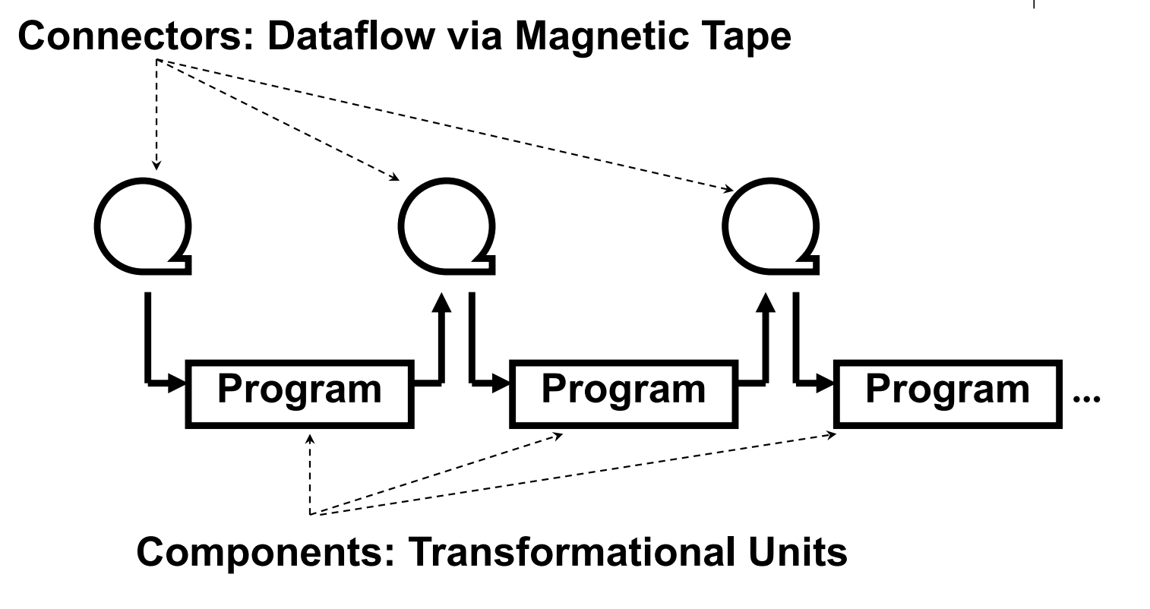
Batch-Sequential

Slide 90
Batch-Sequential
Pros:
simplicity – conceptual integrity
reuse – filters do not depend on other filters for their correctness
modifiability – batch processes can be established
relatively easily using “plumbing mechanism”
Cons:
performance
difficult to create interactive applications
usually requires manual intervention and oversight

Slide 91
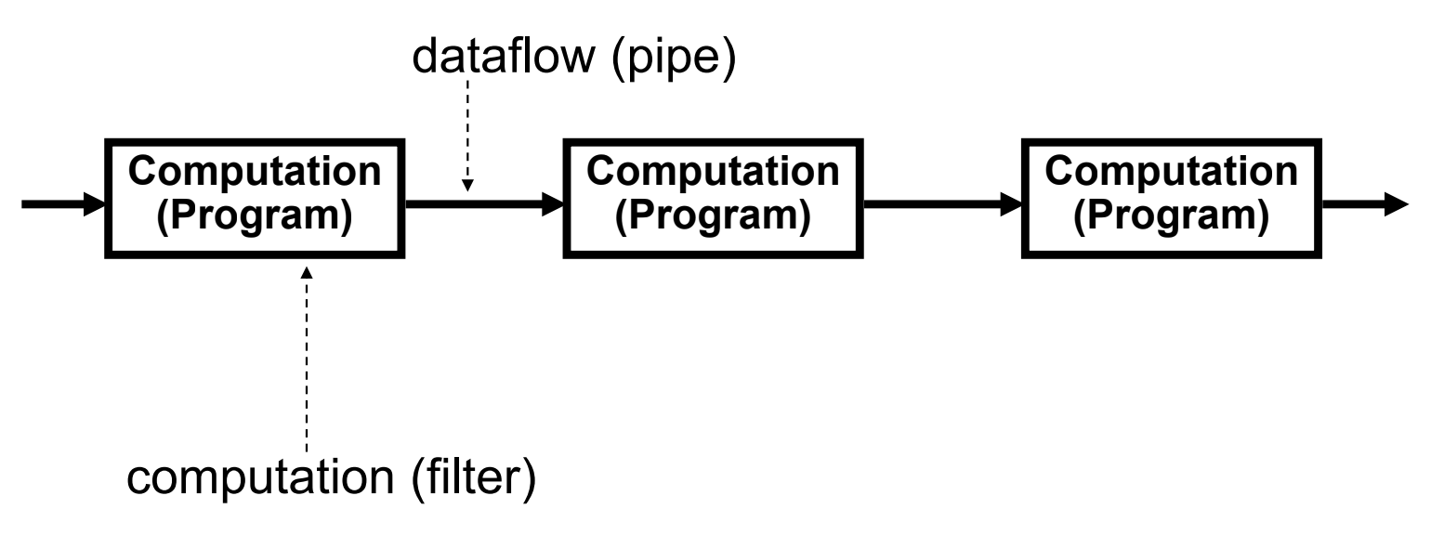
Pipe-and-Filter

Slide 92
Pipe-and-Filter
filters
pipe

Slide 93
Pipe-and-Filter
Pros
simplicity – conceptual integrity
reuse of filters – filters do not depend on other
filters for their correctness
modifiability – late binding of connectors make it
easy to reconfigure a pipe and filter network
Cons
performance
hard to create interactive applications
error detection, handling, and recovery

Slide 94
Batch-Sequential vs Pipe-and-Filter
Both decompose the system into elements interacting only through data passed from one element to another
Batch Sequential
coarse-grained
high latency between processing step
no concurrency
non-interactive
data processed in its entirety at each step
Pipe-and-Filter
fine-grained
presence of data starts processing
concurrency possible
non-interactive
data is incrementally processed

Slide 95
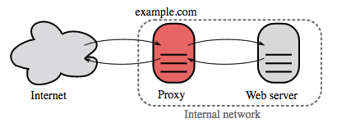
Reverse proxy
A reverse proxy is a web server that centralizes internal services and provides unified interfaces to the public. Requests from clients are forwarded to a server that can fulfill it before the reverse proxy returns the server's response to the client.

Slide 96
Reverse proxy: pros
Increased security - Hide information about backend servers, blacklist IPs, limit number of connections per client
Increased scalability and flexibility - Clients only see the reverse proxy's IP, allowing you to scale servers or change their configuration
SSL termination - Decrypt incoming requests and encrypt server responses so backend servers do not have to perform these potentially expensive operations
Removes the need to install X.509 certificates on each server
Compression - Compress server responses
Caching - Return the response for cached requests
Static content - Serve static content directly
HTML/CSS/JS
Photos
Videos
Etc

Slide 97
Reverse proxy vs Load balancing
Deploying a load balancer is useful when you have multiple servers. Often, load balancers route traffic to a set of servers serving the same function.
Reverse proxies can be useful even with just one web server or application server, opening up the benefits described in the previous section.
Solutions such as NGINX and HAProxy can support both layer 7 reverse proxying and load balancing.

Slide 98
Reverse proxy: cons
Introducing a reverse proxy results in increased complexity.
A single reverse proxy is a single point of failure, configuring multiple reverse proxies (i.e. a failover) further increases complexity.

Slide 99
Relational database management systems
Atomicity - Each transaction is all or nothing
Consistency - Any transaction will bring the database from one valid state to another
Isolation - Executing transactions concurrently has the same results as if the transactions were executed serially
Durability - Once a transaction has been committed, it will remain so

Slide 100
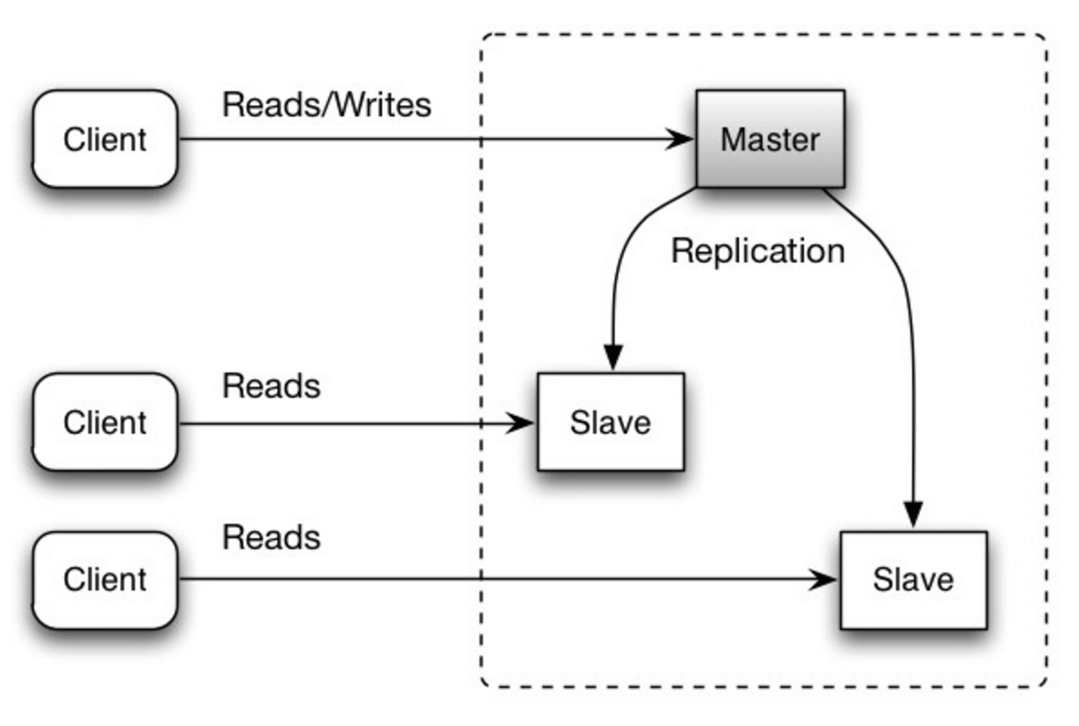
Replication: master-slave
Pros:
Read performance
Reliability
Cons:

Slide 101
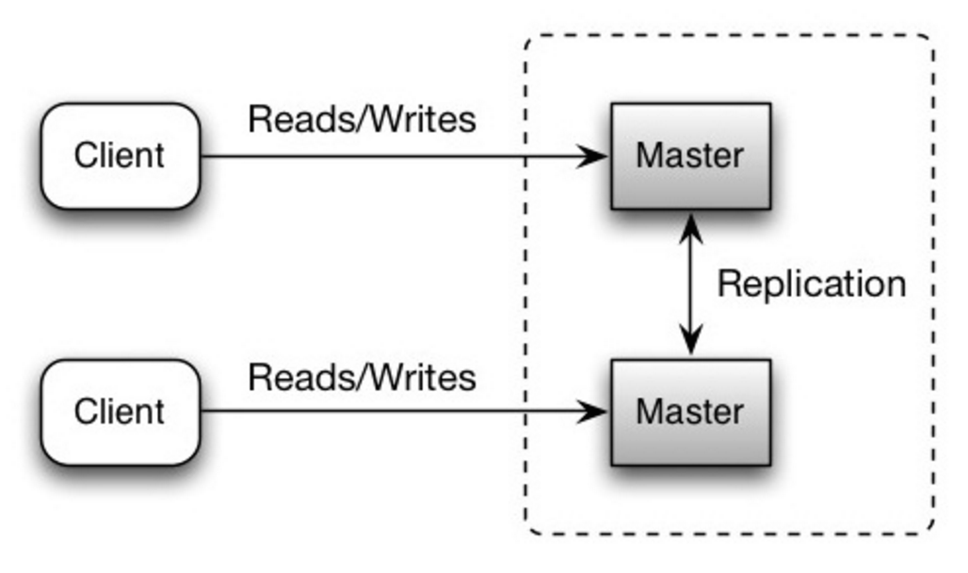
Replication: master-master
Cons:
You'll need a load balancer or you'll need to make changes to your application logic to determine where to write.
Most master-master systems are either loosely consistent (violating ACID) or have increased write latency due to synchronization.
Conflict resolution comes more into play as more write nodes are added and as latency increases.

Slide 102
Replication: disadvantages
There is a potential for loss of data if the master fails before any newly written data can be replicated to other nodes.
Writes are replayed to the read replicas. If there are a lot of writes, the read replicas can get bogged down with replaying writes and can't do as many reads.
The more read slaves, the more you have to replicate, which leads to greater replication lag.
On some systems, writing to the master can spawn multiple threads to write in parallel, whereas read replicas only support writing sequentially with a single thread.
Replication adds more hardware and additional complexity.

Slide 103
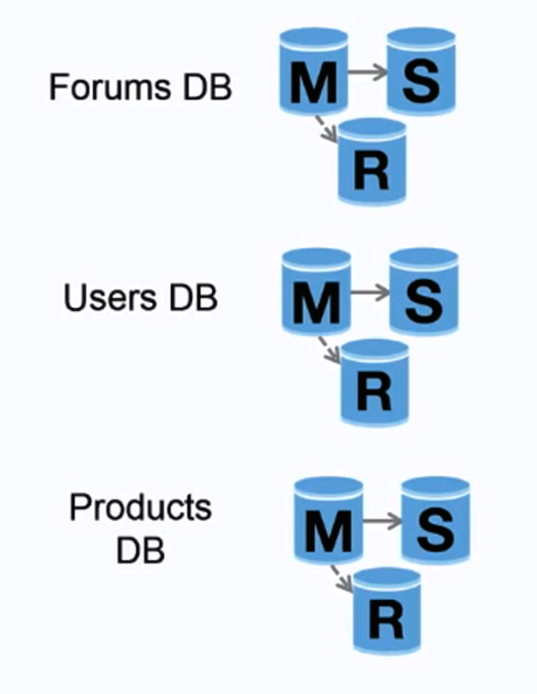
Federation
Federation (or functional partitioning) splits up databases by function. For example, instead of a single, monolithic database, you could have three databases: forums, users, and products, resulting in less read and write traffic to each database and therefore less replication lag. Smaller databases result in more data that can fit in memory, which in turn results in more cache hits due to improved cache locality. With no single central master serializing writes you can write in parallel, increasing throughput.

Slide 104
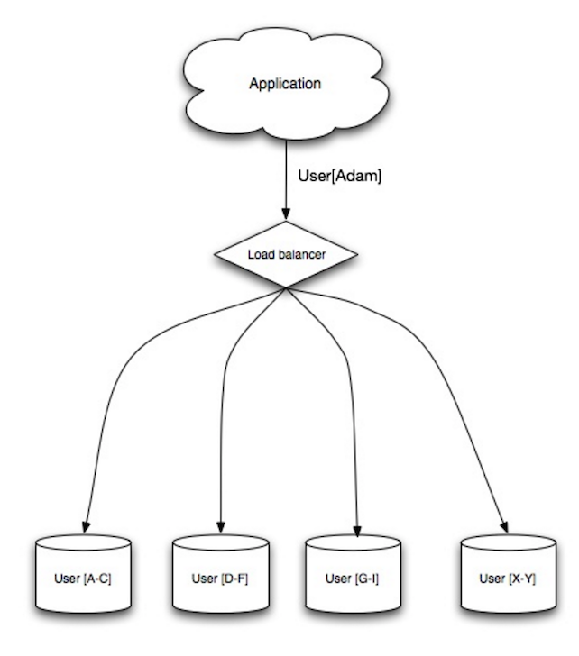
Sharding
You'll need to update your application logic to work with shards, which could result in complex SQL queries.
Data distribution can become lopsided in a shard. For example, a set of power users on a shard could result in increased load to that shard compared to others.
Rebalancing adds additional complexity. A sharding function based on consistent hashing can reduce the amount of transferred data.
Joining data from multiple shards is more complex.
Sharding adds more hardware and additional complexity.

Slide 105
Denormalization
OLAP – online analytical processing

Slide 106
CAP-theorem
Consistency - Every read receives the most recent write or an error
Availability - Every request receives a response, without guarantee that it contains the most recent version of the information
Partition Tolerance - The system continues to operate despite arbitrary partitioning due to network failures

Slide 107
No-SQL
Not only SQL
BASE instead of ACID
Basically available - the system guarantees availability.
Soft state - the state of the system may change over time, even without input.
Eventual consistency - the system will become consistent over a period of time, given that the system doesn't receive input during that period.
3 types:
Key-value
Document
Big table
Graph

Slide 108
No-SQL: key value
HashTable
Examples:
Redis
Memcached

Slide 109
No-SQL: Document store
A document store is centered around documents (XML, JSON, binary, etc), where a document stores all information for a given object. Document stores provide APIs or a query language to query based on the internal structure of the document itself.
Examples:
MongoDB
CouchDB
ElasticSearch

Slide 110
No-SQL: Big table
A wide column store's basic unit of data is a column (name/value pair). A column can be grouped in column families (analogous to a SQL table). Super column families further group column families. You can access each column independently with a row key, and columns with the same row key form a row. Each value contains a timestamp for versioning and for conflict resolution.
Examples:
BigTable
HBase
Cassandra

Slide 111
No-SQL: Graph database
In a graph database, each node is a record and each arc is a relationship between two nodes. Graph databases are optimized to represent complex relationships with many foreign keys or many-to-many relationships.
Examples:
Neo4j

Slide 112
SQL vs No-SQL
SQL:
Structured data
Strict schema
Relational data
Need for complex joins
Transactions
Clear patterns for scaling
More established: developers, community, code, tools, etc
Lookups by index are very fast
No-SQL:
Semi-structured data
Dynamic or flexible schema
Non-relational data
No need for complex joins
Store many TB (or PB) of data
Very data intensive workload
Very high throughput for IOPS

Slide 113
Readings
Books:
Architecting Software Intensive Systems: A Practitioners Guide 1st Edition Anthony J. Lattanze
Documenting Software Architectures: Views and Beyond 2nd Edition Paul Clements, Felix Bachmann, Len Bass
Software Architecture in Practice (SEI Series in Software Engineering) 3rd Edition Len Bass, Paul Clements Rick Kazman
Whitepapers:
Google File System
Big Table
MapReduce: Simplified Data Processing on Large Clusters
Scaling Memcache at Facebook
TAO: Facebook’s Distributed Data Store for the Social Graph
Paxos vs Raft: Have we reached consensus on distributed consensus?
Other resources:
System design premier https://github.com/donnemartin/system-design-primer
High scalability http://highscalability.com/
High load https://www.highload.ru/

